Slide 1
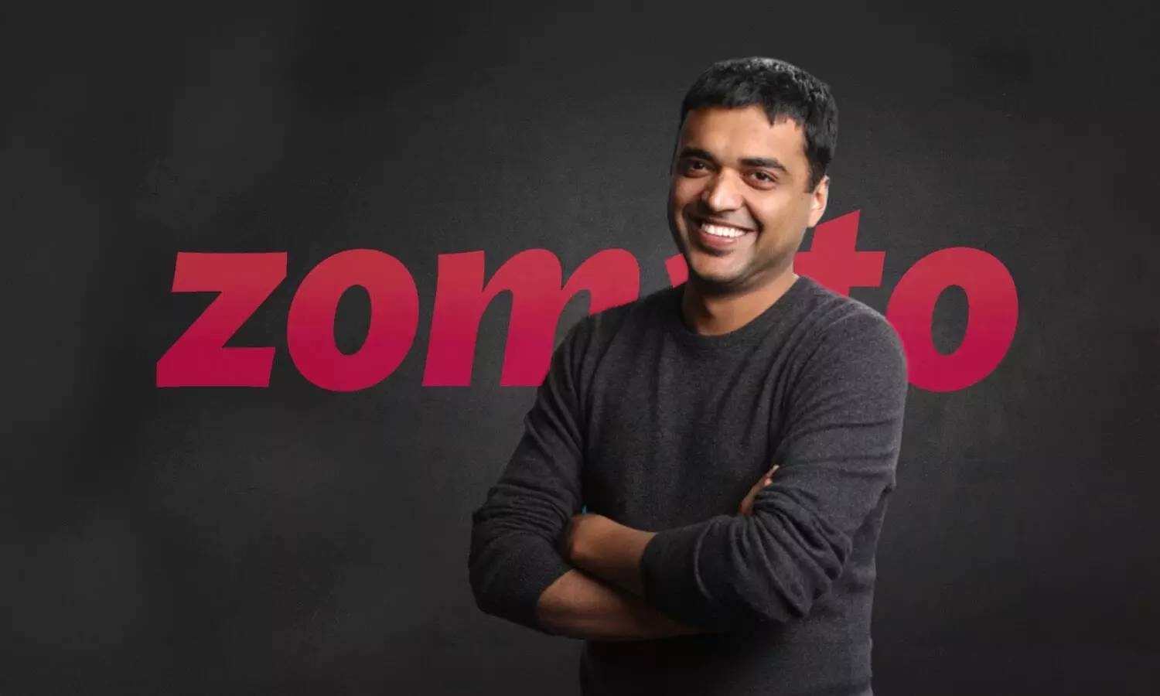
Data Analysis Project using python
Zomato’s food delivery business serves an average of 17.5 million monthly transacting customers, with the number of active restaurant partners growing by 8.7% year-on-year, from 208,000 to 226,000. To sustain this growth and improve operational efficiency, Zomato has collected a dataset of customer interactions, preferences, and transaction histories.
The challenge is to analyze this dataset to derive actionable insights, focusing on:
1.Customer Segmentation: Identify distinct customer groups based on behavior and preferences for targeted marketing.
2.Restaurant Performance: Evaluate restaurant partner performance to identify trends and improvement opportunities.
3.Demand Forecasting: Predict regional demand to optimize delivery logistics and resource allocation.
4.Customer Retention: Analyze factors influencing churn and develop strategies to improve retention.
5. Operational Efficiency: Identify and address bottlenecks in the delivery process to enhance customer satisfaction.
The goal is to leverage these insights to improve customer experience, support restaurant partners, and drive sustainable growth for Zomato’s food delivery business.

Slide 2
As a data professional, you need to analyze the data, perform EDA (Exploratory Data Analysis) and visualization, and answer the following questions:
What type of restaurant do the majority of customers order from?
How many votes has each type of restaurant received from customers?
What are the ratings that the majority of restaurants have received?
Zomato has observed that most couples order most of their food online. What is their average spending on each order?
Which mode (online or offline) has received the maximum rating?
Which type of restaurant received more offline orders, so that Zomato can provide those customers with some good offers?
ZOMATO

Slide 3
 | Name | Online_Order | book_table | Rate | Votes | approx_cost (for two people) | listed_in (type)
0 | Jalsa | Yes | Yes | 4.1/5 | 775 | 800 | Buffet
1 | Spice elephant | Yes | No | 4.1/5 | 787 | 800 | Buffet
2 | San Churro Cafe | Yes | No | 3.8/5 | 918 | 800 | Buffet
3 | Addhuri Udupi Bhojana | No | No | 3.7/5 | 88 | 300 | Buffet
4 | Grand Village | No | No | 3.8/5 | 166 | 600 | Buffet
... | ... | ... | ... | ... | ... | … | …
143 | Melting Melodies | No | No | 3.3/5 | 0 | 100 | Dining
144 | New Indraprasta | No | No | 3.3/5 | 0 | 150 | Dining
145 | Anna Kuteera | Yes | No | 4.0/5 | 771 | 450 | Dining
146 | Darbar | No | No | 3.0/5 | 98 | 800 | Dining
147 | VijayLakshami | Yes | No | 3.9/5 | 47 | 200 | Dining
This is the data frame of the Zomato Data Analysis Project

Slide 4
Graphs used:
Bar Chart
Line Graph
Bar Chart
Histogram
Box Plot
Heat Map

Slide 5
1) What type of restaurants do majority of customers order from? The table showcases five buffet-style restaurants, providing details about their online ordering and table booking options, ratings, number of votes, and approximate costs for two people. Most restaurants offer online ordering, but only one supports table bookings. Ratings range from 3.7 to 4.1, with varying numbers of votes. Costs also vary, with the most affordable being 300 INR for two people.
 | name | Online_order | Book_table | rate | votes | Approx_cost (for two people) | Listed_in(type)
0 | Jalsa | Yes | Yes | 4.1 | 775 | 800 | Buffet
1 | Spice Elephant | Yes | No | 4.1 | 787 | 800 | Buffet
2 | San Churro Café | Yes | No | 3.8 | 918 | 800 | Buffet
3 | Addhuri Udupi Bhojana | No | No | 3.7 | 88 | 300 | Buffet
4 | Grand Village | No | No | 3.8 | 166 | 600 | Buffet

Slide 6
The table gives an overview of five buffet restaurants, noting if they support online ordering and table bookings, along with their ratings, votes, and approximate costs for two people. Most restaurants offer online orders, but only one allows table bookings. The ratings range from 3.7 to 4.1, with costs varying, the lowest being 300 INR for two.

Slide 7
2) How many votes has each type of restaurant received from customers? Based on your previous messages and code, the graph you're trying to create is a boxplot. A boxplot visually displays the distribution of numerical data through their quartiles, highlighting the median, quartiles, and potential outliers. It's particularly useful for comparing the spread and central tendency of data across different categories.

Slide 8
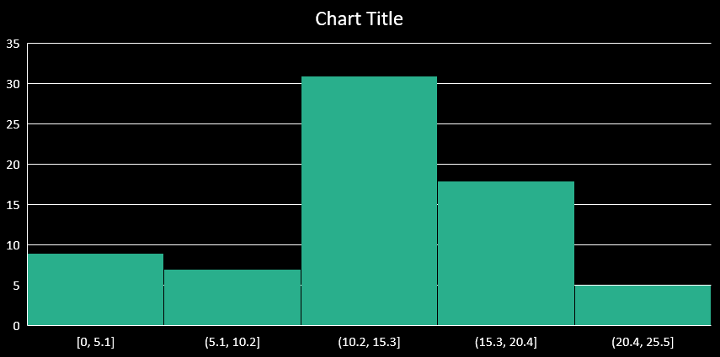
3) What are the ratings that the majority of restaurants have received? The graph illustrates the distribution of restaurant ratings. Most ratings cluster around 4.00, showing a high level of customer satisfaction. Ratings range from 2.50 to 4.50, with fewer ratings at the extremes. This spread indicates a generally positive dining experience across these establishments.

Slide 9
4) Zomato has observed that most couples order most of their food online. What is their average spending on each order? In this dataset, we examined the distribution of approximate costs for dining experiences for two people. The data revealed that the most common cost is around 300, with over 20 occurrences. Other significant price points include 200, 400, 500, and 800, each appearing between 10 to 15 times. This indicates a diverse range of dining costs, with a notable concentration around certain price points. This information can be valuable for understanding typical dining expenses and identifying popular price ranges for meals for two.

Slide 10
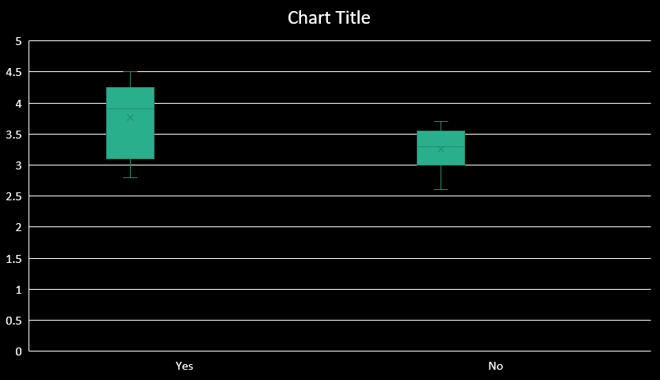
5) Which mode (online or offline) has received the maximum rating? The box plot shows the ratings given by customers who ordered online ("Yes") versus those who did not ("No"). The ratings for online orders tend to be higher, with a median rating of around 4.0, indicating that customers are generally more satisfied. The interquartile range (IQR) for online orders is between 3.75 and 4.25, with a few outliers around 3.0. On the other hand, the ratings for non-online orders have a lower median rating of around 3.5, with the IQR ranging from 3.25 to 3.75 and one outlier around 2.75. This comparison suggests that online ordering might contribute to better customer satisfaction overall.

Slide 11
6) The heatmap reveals how different restaurant types offer online ordering. "Dining" establishments dominate both categories, with 77 not offering online orders and 33 offering them. Cafes have a notable number offering online orders, with 15 occurrences. Buffets and "Other" types have lower frequencies, but Buffets still have a significant number of online orders. This helps us understand the distribution of online ordering services across different restaurant types.
80
Heat Map
70
Buffet
3
4
60
50
8
15
40
Cafes
Listed In(type)
30
77
33
20
Dining
10
2
6
Others
No
Yes
Online Order

